Slide 1
Cartel Enforcement and Regulation in Germany
Dr. Romina Polley LL.M.
Competition Law Germany - 26. September 2017, Düsseldorf

Slide 2
Overview
  Cartel Statistics In Germany
  Challenges For Success Of Leniency
  Shift Of Enforcement From Classical Hardcore Cases To Information Exchange And Vertical Infringements
  Settlement Trend Continues
  Appeals Risky Because Of Possible Fine Increase
  Procedural Regime Of Judicial Review Needs To Be Modernized
  Liability For Cartel Activities: Sausage Gap Finally Closed With 9th Amendment Of ARC
  Further Interesting Changes

Slide 3
Cartel Statistics In Germany

Slide 4
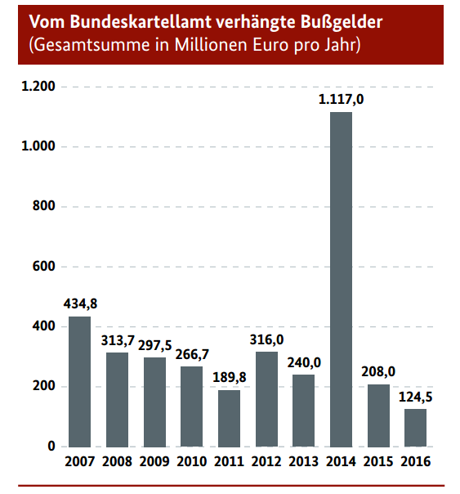
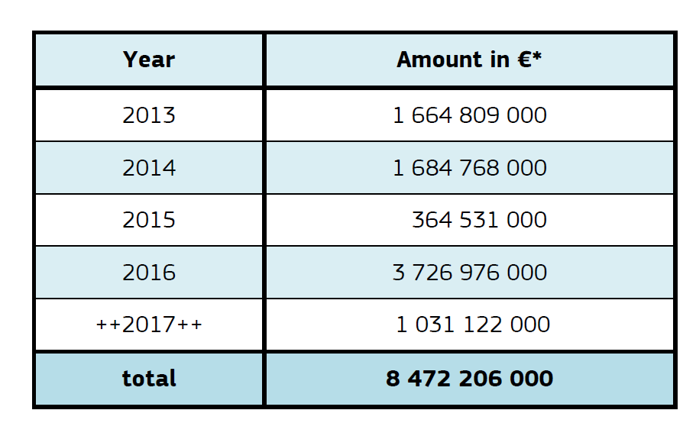
Total Of Fines Imposed By FCO Compared To EU Commission
Cartel Statistics (1)
Fines Imposed by FCO
(total in million € per year)
Fines Imposed by EU Commission
(total in million € per year)
(not adjusted for Court judgements)
48,5
09/2017
(FCO Brochure Successful Cartel Enforcement, 2017)
(For 2017 based on FCO press releases)
Cartel Enforcement and Regulation in Germany

Slide 5
Significant Downward Trend Of Fines Since 2014
Cartel Statistics (2)
Fines Imposed by FCO
(total in million € per year)
The total amount of fines imposed by the FCO declined by 81 % from 2014 to 2015 and further declined
by 40 % from 2015 to 2016
No indication from 2017 figures that trend will reverse
How can this downward trend be explained?
48,5
09/2017
(FCO Brochure Successful Cartel Enforcement, 2017)
(For 2017 based on FCO press releases)

Slide 6
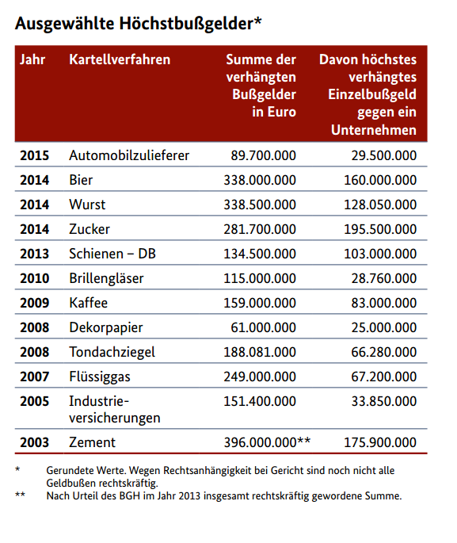
Possible Explanation For Extreme Decrease: Peak Year 2014
Cartel Statistics (3)
The FCO explains the downward-trend in fines with the conclusion of several bigger cases in 2014
Indeed, total of fines imposed prior to 2014 ranged between € 190 million and € 435 million in the years between 2007 and 2013
Also due a loophole in the German legislation, the FCO could not enforce penalties of around € 128 million in the so-called ”sausage cartel“
However, fines in 2016 were again lower than in 2015 and trend is not yet reversed by 2017 figures
(FCO Brochure Successful Cartel Enforcement, 2017)

Slide 7
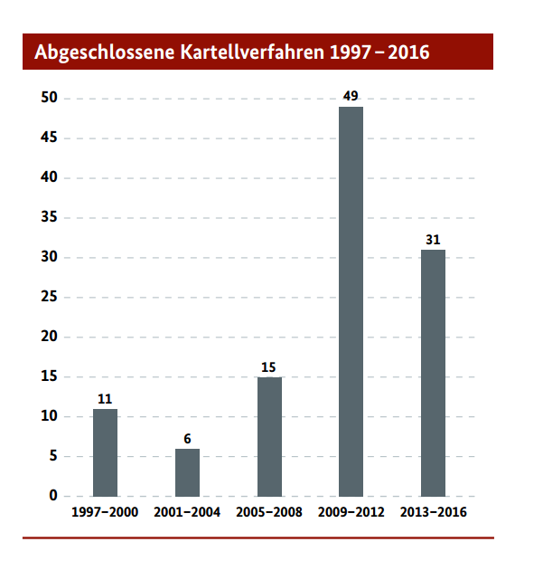
Decreased Number Of Closed Cases
Cartel Statistics (4)
Absolute number of completed proceedings decreased as well in the period of 2013-2016 as opposed to 2009-2012
Is the FCO less active,
Are there less cartels,
Are the cases more complex or
Are there less leniency applications?
Completed Cartel Proceedings 1997 – 2016
(FCO Brochure Successful Cartel Enforcement, 2017)

Slide 8
Challenges For Success Of Leniency

Slide 9
Leniency Statistics
Challenges for Success of Leniency (1)
  FCO publishes number of applications filed, but figures do not show percentage of leniency cases out of total cases (FCO Brochure Successful Cartel Enforcement, 2017):
  Slightly more than half of the cases initiated based on immunity (Quote from Brochure)

Slide 10
Conclusions From German Leniency Statistics
Challenges for Success of Leniency (2)
  Number of leniency applications in Germany dropped in 2016, but too early to see waning success of leniency
  Leniency statistics are only indicative over a period of several years
  However, figures show high dependence of FCO’s cartel enforcement on leniency
  Leniency has always had its risks, but in the following categories more recent risks to the success of LPs have developed
    Handling of leniency applicants by the competition authorities
    Disincentives to apply for leniency in the sphere of the companies
    External factors increasing the risks of leniency

Slide 11
Risks To Leniency Arising From Competition Authorities
Challenges for Success of Leniency (3)
  Multi-jurisdictional cartel investigations including countries with little domestic impact increase unpredictability for applicants
        Unknown financial exposure
        Double jeopardy risk
        Protection of confidential information not guaranteed
        Conflicts in LPs and differences in evidence standards
        Rights of defense at risk
  Enlargement of notion of hardcore cartel risks has created uncertainty and clogs the system
        Information exchange
        Hub & Spoke
        No uniform treatment of secrecy requirement
  More generous publication/disclosure of evidence to third parties

Slide 12
Disincentives To Leniency In The Sphere Of The Companies
Challenges for Success of Leniency (4)
  Lack of evidence after years of compliance programs and increased concealment efforts by individuals engaged in relevant conduct supported by digital technology
  Increasing formalism in internal investigations, e.g. due to data protection law, counsel to individuals, information companies requirements, etc.
  Companies lack of willingness to indemnify individuals
  Tendency to report borderline conduct to get protection
  Increased cost of investigations because of growing data volumes and increasing number of jurisdictions becoming active in cartel enforcement

Slide 13
External Threats To Leniency
Challenges for Success of Leniency (5)
  Increased follow-on damages activity further fostered by implementation of Damages Directive constitutes growing threat to LPs
    Immunity applicant still exposed more than others despite limitation of liability and contribution claims (Article 11 Damages Directive)
    Disclosure of incriminating documents to private plaintiffs by CAs (Article 6 Damages Directive)
  Criminalization of cartel conduct creates disincentive to make use of LPs
    In many jurisdictions criminal liability and LPs are not finetuned
    Makes internal investigations more difficult for lack of cooperation by individuals
    Deters companies from making leniency applications because they cannot protect their employees

Slide 14
Specific Features Of The German Leniency Regime
Challenges for Success of Leniency (6)
  Pros:
    The timing and value-add of the application are taken into account by the FCO in contrast to the European regime where the timing is the key factor
    In practice, the FCO grants significant discounts (up to 20%) to lower-ranking applicants in order to encourage them to cooperate
    In some cases lower-ranking applicants have obtained higher discounts than the companies ranking before them if the value add was particularly strong
    A marker is granted as a routine matter also for lower ranking applicants which increases the incentive to cooperate after the inspection
  Risk:
    Lower-ranking applicants have a strong incentive to report additional conduct, which bears the risk of exaggeration in a procedural system where oral testimony has higher value than written evidence

Slide 15
Shift From Classical Hardcore Cases To Information Exchange And Vertical Infringements

Slide 16
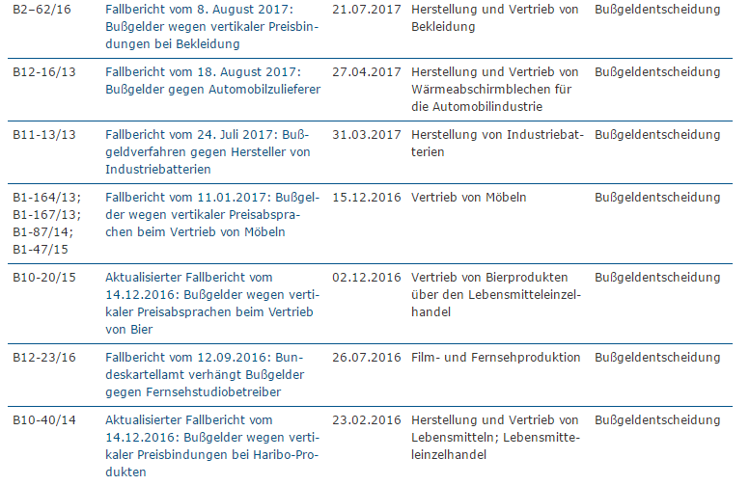
Antitrust Proceedings Concluded In 2016 Until August 2017
From Hardcore Infringements to other Infringements (1)
Out of 10 closed proceedings in
2016 – 9/2017
Only 3 concerned
horizontal hardcore cartels
Whereas 7 regarded
  vertical price-fixing-
  agreements,
  information exchanges and
  other atypical cartels
Fines were imposed in 7 of 10 cases:

Slide 17
FCO Prosecution of Atypical Cartels
From Hardcore Infringements to other Infringements (2)
  Less classical hardcore cartels, instead more coordinated practices
  Information exchange of business secrets other than price, Signaling, Hub and Spoke
  Not only exchanges on future pricing information, but also current turnover figures, terms and conditions, customer requirements, status of commercial negotiations, etc.
  Encouraged by case-law of CJEU and the FCJ
    ECJ: Companies engaged in bilateral pre-pricing communications during which they discussed banana price-setting factors relevant to the setting of quotation prices for the forthcoming week, or discussed or disclosed price trends
    Judgment of March 19, 2015, C‑286/13 P, ECLI:EU:C:2015:184, para. 14 – Bananas
    FCJ, decision of April 3, 2014, KRB 46/13 confirming Düsseldorf Court of Appeals, judgement of October 29, 2012, V-1 Kart 1-6/12 (OWi) – Silostellgebühren I (price increase had already been communicated to customers)

Slide 18
FCO Information Exchange Cases Since 2013
From Hardcore Infringements to other Infringements (3)
  5 cases regarding information exchange closed since 2013
    Fines against television studio operators („Fernsehstudiobetreiber“), decision of July 27,2016
    Fines against confectionary manufacturers („Vierer-Runde“ and „Konditionenvereinbarung“), decision of January 31, 2013 und June 2014; Recently confirmed by Düsseldorf Court of Appeals, judgement of January 26, 2017
    Fines against manufacturer of drugstore products („Drogerieartikel“), decision of February 2008–March 2013
    Fines against manufacturer of consumer goods („HEMA“), decision of February 2011 and 22.03.2013
    Fines against manufacturer of household dishes („Haushaltsgeschirr“), decision of October 16, 2013

Slide 19
Settlement Trend Continues

Slide 20
Majority Of Proceedings Were Settlements In 2015–8/2017
Settlement Trend Continues (1)
  11 out of 11horizontal cartel cases were settlement cases back between 2015 and 8/2017
      Manufacturers and retailers of heat shields in the automotive industry, B12-16/13, decision of April 27, 2017
      Manufacturers of industrial batteries, B11-13/13, decision of March 31, 2017
      Wholesalers in the sanitary, heating and air conditioning sector, B5-139/12, decision of March 22, 2016
      TV-Studios, B12-23/15, decision of July 26, 2016
      Machine- and equipment construction and tracks, B12-19/12, decision of March 10, 2016
      Manufacturers of concrete and wooden railway sleepers, B12-14/12, decision of February 25, 2016
      Advertising journals, B7-117/14-1, decision of December 8, 2015
      Container transport services, B12-24/13, decision of August 25, 2015
      Suppliers of so-called rubber track pads and vibration dampers for military vehicles, B12-14/13, decision of July 16, 2015
      Automotive supplier of acoustic parts, B12-13/13, decision of June 24, 2015 and December 18, 2015
      Manufacturers of prefabricated garages, B12-15/12, decision of June 16, 2015
  Settlements in most cases with all cartel members, but FCO not shy to pursue hybrid settlements

Slide 21
Pros and Cons of settlements in Germany
Settlement Trend Continues (2)
  ADVANTAGES
  Ability to negotiate scope of infringement and level of fine with FCO in constructive manner
  Fine reduction of 10% on top of leniency
  Faster legal security
  Lower internal and legal cost
  Reduction of risk in subsequent follow-on litigation because of shorter final decision
  Appeal remains possible even on the facts because Düsseldorf Court of Appeals engages in independent assessment of the facts
  DISADVANTAGES
  Admission of underlying facts makes defense in follow-on damages cases difficult
  Curtailed rights of defense, e.g., no full access to file; in some cases, not even SO but summary of facts
  Open legal questions remain unresolved in the absence of appeal
  In Germany, possible role of accuses individuals as witness in procedures against non-settling parties
  Risk that other cartel members manage to reduce fine in appeal and settling company does not benefit
  Greater exposure to civil follow-on damages litigation due to timely closure of proceedings

Slide 22
Differences Of German Settlement Regime Compared To EU Process
Settlement Trend Continues (3)
  No detailed regulatory settlement package
  (Information Leaflet on FCO Settlement Procedure in fine proceedings, February 1, 2016)
  FCO can agree to settlement at any stage of the proceedings
  FCO normally provides summary of facts and prepared amount of the fine in initial meeting
  Factual circumstances often not yet fully investigated because no SO yet
  Scope of infringement and level of fine mostly negotiable
  Strong bargaining power for FCO because of limited chances of success before Düsseldorf Court of Appeals
  FCO’s division dealing with the case is empowered to decide upon a settlement autonomously
  FCO more inclined to enter into settlements in hybrid cases

Slide 23
Differences Of The German Settlement Regime Compared To EU Process (cont‘d)
Settlement Trend Continues (4)
  No admission of guilt and liability necessary but only admission of facts
  Judicial review in Germany extends to underlying facts, because Court‘s own assessment
  Settlement parties may be heard as witnesses in court proceedings
Information Leaflet on the Settlement procedure used by the FCO in fine proceedings, effective February 1, 2016 available under:
http://www.bundeskartellamt.de/SharedDocs/Publikation/EN/Merkblaetter/Leaflet_Settlement_procedure.pdf?__blob=publicationFile&v=3

Slide 24
Appeals Risky Because Of Possible Fine Increase

Slide 25
Limited Chances Of A Successful Appeal
Appeals Risky Because of Possible Fine Increase (1)
  Limited chances of successful appeal before the Düsseldorf Court of Appeals
  Practice risk of reformatio in peius
  Fines were raised repeatedly in the past, e.g.:
    The Düsseldorf Court of Appeals raised the fines to be paid for the „condition agreement“ by confectionary manufactures from 19,6 Mio EUR to 21,3 million EUR (~9 %), decision of January 26, 2017, V-4 Kart 6/15 OWi
    The Düsseldorf Court of Appeals raised the fines to be payed by Segafredo Zanetti Deutschland GmbH by around 9 %, decision of December 17, 2015,V-4 Kart 2/15 OWi
    The Düsseldorf Court of Appeals raised the fines for a liquefied gas supplier Cartel around 85%, decision of April 15, 2013, VI-4 Kart 2-6/10 OWi

Slide 26
Withdrawn Appeals
Appeals Risky Because of Possible Fine Increase (2)
  The majority of appeals are being withdrawn
E. g. Appeal against
    Fines against confectionary manufacturers („Vierer-Runde“ and „Konditionenvereinbarung“), decision of January 2013 und June 2014
    Fines against manufacturers of drugstore products („Drogerieartikel“), decision of February 2008 and March 2013
    Fines against companies in the flour cartel, decisions from October 2011 until February 2013
    Fines against manufacturers of automatic door systems and their trade association, decision of July 2012
  In October 2015 Geze GmbH withdrew its appeal because the Düsseldorf Court of Appeals indicated it was going to raise the fine significantly (Activity report of the FCO, p. 73)

Slide 27
Procedural Regime Of Judicial Review Needs To Be Modernized

Slide 28
Need for reform of current German fine decision appeal procedure
Current system of legal review of fine decisions not suited for complex cartel cases is inefficient and in practice truncates complainants' right to access to justice
Court conducts de novo investigation of all facts and legal issues in oral hearing (no possibility to limit appeal to amount of the fine)
FCO file does not form part of the Court proceedings, pieces of evidence can only be introduced into Court hearing by order of the presiding judge
Principle of direct oral evidence to be taken in the oral hearing leads to endless witness hearings
Significant risk of reformatio in peius because complainant does not control scope of review discourages appeals
Public prosecutor's role in appeal proceedings taking over file from FCO takes time and they lack competition law expertise

Slide 29
Need for reform of current German fine decision appeal procedure
Procedure similar to European system would be preferable
Legality review where FCO reviews legality of FCO decision instead of de novo investigation would be more efficient
Unlimited jurisdiction over the amount of the fine would guarantee that Court stays in control
Adversarial system where Court review is limited to claims made by complainant is preferable to ex officio system and reduces risk of reformation in peius, e.g. appeal only on amount of fine; Court can ex officio check certain minimum requirements, e.g. appropriate reasoning
Such a system would be in line with fundamental rights standard established by ECtHR ("Menarini")
Liability for fines has already been harmonized with European law on single undertaking, procedural harmonization only being the next step

Slide 30
Need for reform of current German fine decision appeal procedure
Practical steps to streamline the system
FCO file should become part of the Court proceedings
Strict oral procedure where all evidence taken into account by Court needs to be presented in the oral hearing should be abandoned
Priority of oral evidence over written evidence should be replaced by more flexible evidence standard, Court should decide on most convincing type of evidence
On the basis of FCO's file the Court could more easily reject unnecessary motions to take evidence
Complainants would be sufficiently protected by right to challenge elements in the file
FCO should take over rule of public prosecutor

Slide 31
Liability For Cartel Activities

Slide 32
Sausage Gap – Circumventing Liability Through Restructuring
Liability for Cartel Activties (1)
  On July 15, 2014 the FCO had imposed fines totaling around € 338 million on 21 sausage manufacturers and 33 individuals involved
  Two companies involved in the cartel Böklunder and Könecke escaped liability from fines in the total amount of EUR 128 million,
    By transferring major assets to other companies of the group and
    Subsequently dissolving the companies that were addressees of the FO’s fine decision.
  Such restructuring was lawful, because the FCJ required economic identity of the legal successor of a fine addressee, see BGH, decision of August 10, 2011 - KRB 55/10
  As a result further companies engaged in restructurings and escaped liability, e.g. in the confectionary cartel, in the clay roof tile cartel)

Slide 33
Fines after the 9th Amendment of the ARC
Liability Of The Parent Company (Section 81(3a) Of The ARC)
Liability for Cartel Activties (1)
  Former German law: formal concept of legal independence
    Although the do’s and don’ts of competition law are addressed to the undertaking as a whole
    Until now, no legal basis existed for a parent company to be held liable for infringements of competition law committed by its subsidiaries
    Therefore, corporate groups could have been incentivized to provide its subsidiaries with limited funding
  European concept of undertaking
    Single economic entity, even if it technically consists of multiple legal entities
    Unitary organization with decisive influence on the commercial policy
  The 9th Amendment provides for the possibility to fine a parent company with decisive influence on the Infringing Entity—without having to prove complicity (“Liable Parent Company”)
Legal independence:
Parent company
Infringing Entity
Subsidiary
Subsidiary
“Undertaking” = single economic entity:
Parent company
Infringing Entity
Subsidiary
Subsidiary

Slide 34
Fines after the 9th Amendment of the ARC
Universal Succession (Section 81(3b) Of The ARC)
Liability for Cartel Activties (2)
  Adaptation of the EU fining system
    ECJ, case C-448/11 P – SNIA / Commission (2013): the liability for antitrust infringements with regard to fines is transferred to the universal successor
    ECJ, case C-343/13 – Modelo Continente Hipermercados (2015): the obligation to pay a fine imposed by a final decision adopted after the merger for infringements committed by the acquiring company prior to the merger is transferred to the acquiring company
  German successor liability is intensified (Section 30(2a) of the German Administrative Offences Act)
    Until the 9th Amendment, only the economically identical successor of the Infringing Entity could be fined
    The successor‘s liability was limited to the net worth of the acquired assets and a fine appropriate for the predecessor’s undertaking
  Now: Also the universal successor of a Liable Parent Company can be fined and a successor’s liability is neither limited to the net worth of the acquired shares nor to a fine appropriate for the predecessor’s undertaking
Until now:
New system:
Parent company
No liability
Universal successor
No liability
Infringing Entity
Limited liability
Universal successor
Parent company
Unlimited liability
Universal successor
Unlimited liability
Infringing Entity
Unlimited liability
Universal successor

Slide 35
Fines after the 9th Amendment of the ARC
Economic Succession (Section 81(3c) Of The ARC)
Liability for Cartel Activties (3)
  The revised law aims at filling the so-called “sausage gap”
    Due to corporate restructuring measures, fines in the amount of € 120 million could not be imposed on two members of the “sausage cartel”
  Possibility to fine the economic successor of the Infringing Entity
  Following the European “undertaking” concept
  Concerns both group-internal and group-external transfers of individual assets (asset deals)
  The decisive criterion is “economic continuity”
    The concept of economic continuity is well-defined by case law of the European Commission as well as European courts
      The entity that has committed the infringement has ceased to exist, either in law or economically (ECJ, case C-280/06 – ETI (2007))
      The successor acquires the Infringing Entity’s assets, wholly or partly, and continues its economic activities (CFI, case T-6/89 – Anic / Commission (1991); CFI, case T-259/02 – Raiffeisen Zentralbank Österreich / Commission (2006))
  The revised law goes beyond merely filling the sausage gap:
  IT also Concerns group-external transfers of assets too

Slide 36
Fines after the 9th Amendment of the ARC
Liability During The Transitional Period (Section 81a Of The ARC)
Liability for Cartel Activties (4)
  Due to the constitutional prohibition on retroactivity (Article 103(2) of the German constitution), the new fining provisions (liability of parent companies, universal succession, economic succession), only apply to infringements committed after June 9, 2017
  Section 81a of the ARC (new): “Liability during the transitional period”
    Additional legal basis for liability in cases where the infringement has already ceased once the revised law enters into force
    In the event that, after administrative proceedings are initiated, the Infringing Entity ceases to exist or its assets are moved hindering the imposition or enforcement of fines against the entity itself or its legal successor
    An “amount of liability” can be determined (equivalent to a fine appropriate for the undertaking) to be paid by
      parent companies that, if the revised fining rules applied, would be Liable Parent Companies in the sense of Section 81(3a) of the ARC at the time administrative proceedings are initiated
      universal successors
      economic successors
    Only concerns restructurings taking place after the 9th Amendment entered into force (Section 186(5) of the ARC)
“Due to the sometimes significant duration of administrative fine proceedings, there would be incentives and possibilities in several cases—especially in ongoing investigations—to evade the imposition and enforcement of an appropriate fine.”(justification by the German government)

Slide 37
Fines after the 9th Amendment of the ARC
Constitutional Concerns
Liability for Cartel Activties (5)
  Problem, when aligning German with EU fining rules:
    EU fines not of criminal law nature (see Article 23(5) of Regulation No 1/2003)
    In Germany, administrative offences law = “criminal law light”
  Liability of parent companies:
    In dubio pro reo: if the presumption—existing under EU law—that a decisive influence is exercised on wholly-owned subsidiaries is adopted for purposes of German law
    Principle of fault: parent companies are penalized solely based on structural connection
  Economic succession:
    Principle of fault/proportionality: the mere acquisition of tainted assets is giving rise to liability—irrespective of fault/knowledge
  Liability during the transitional period
    Prohibition on retroactivity: Although liability is technically linked to the cessation of the Infringing Entity’s existence/the moving of its assets occurring after administrative proceedings are initiated, in practice the revised law retroactively penalizes infringements that otherwise could not be sanctioned anymore
“The implementation of sanctions targeted at the undertaking according to Section 81(3a)–(3e) adheres to the European principle of effectiveness and, at the same time, complies with rules of law and constitutional premises. In particular, there is no threat of a violation of the principle of fault or the principle of proportionality”
(justification by the German government)
“If undertakings are legally able to avoid paying fines subsequent to their imposition, this might constitute a real issue that needs to be addressed by the legislator. In the case of the ‘sausage gap’, however, a legislative change is being considered that is unnecessarily extensive and according to German standards unconstitutional.”
(opinion from the Federation of German Industry, BDI)

Slide 38
Further Interesting Changes

Slide 39
Register For Competition – To Be Fully Established By 2020
Further Interesting Changes (1)
  On June 1, 2017 the Bundestag passed the act introducing a register for competition in public procurement “WRegG”
  The central federal electronic register shall record serious violations of competition law and be kept by the FCO
  Record can lead to exclusion of companies from the award of public contracts for up to 3 or 5 years
  Public-sector customers and grantors of concession have margin of discretion for exclusion of bidders in case of competition infringements (Section 124 GWB)
  Listings can be deleted prematurely from the register if company takes self-cleaning measures
  Binding effect of assessment of self-cleaning measures by FCO
  Judicial review through appeal before the Düsseldorf Court of Appeals

Slide 40
Publication of cartel decisions
Further Interesting Changes (2)
  Creation of an express legal basis for the FCO to publish reports on its activities and on the situation and development within its field of responsibilities (Section 53(4) of the ARC)
  The FCO should communicate every decision imposing fines on its website (Section 53(5) of the ARC)
    Potential victims should be provided with the necessary information to check claims for damages
    Therefore, the notice should include:
      Information about the facts of the case
      Information about the nature and time of the violation
      Information about the affected goods and services
      Information about the possibility to claim damages
      Information about the binding effect of a competition authority’s decision (Section 33b of the ARC)

Slide 41
Further Changes Brought About By The 9th Amendment –
Consumer Protection
Further Interesting Changes (3)
Consumer protection
  So far: possibility of a sector inquiry by the FCO or the highest regional authorities in case of suspected restrictions or distortions of competition
  Section 32(5) of the ARC (new): also in case of a reasonable suspicion of substantial, permanent or repeated infringements of consumer law that affect by reason of their nature or size the interests of a large number of consumers
    e.g. violations of the Act against Unfair Competition or rules on general terms and conditions of business
  No authority for entering into premises for the purpose of inspection and examination of documents and for conducting searches (exclusion of Section 59(1) first sentence No. 3, (2)–(4) of the ARC)
  Basis for this revision was a discussion regarding an extensive expansion of the FCO‘s responsibilities to the area of consumer protection

Slide 42
Thank you for your attention!

